Slide 1
CCAR
Aug 2nd, 2018

Slide 2
What is CCAR?
CCAR stands for Comprehensive Capital Analysis and Review, and is defined as a federally-required stress test that is held annually to determine the financial resilience of the nation’s large bank holding companies (BHCs).
The Federal Reserve supplies scenarios to test each bank holding companies’ ability to continue operations, even during financial shock.
The idea is to determine whether a large bank holding company’s internal processes are sufficient to handle all of the relevant risks
CCAR requires accurate reporting, agreement to federal recommendations, and a commitment to uphold the plans stated during the test.

Slide 3
CCAR History
CCAR regulation was inspired by the 2008 economic collapse
Following the financial crisis, came broader focus on stress testing and capital adequacy mainly due to the 2010 Dodd-Frank Act.
Beginning in 2011, new regulations in the United States required the submission of Comprehensive Capital Analysis and Review (CCAR) documentation for the banking industry.
In 2014, several BHCs struggled with their CCAR tests and, as a result, proficiency with CCAR stress testing became a key factor in recruitment within banking and finance industries.
In 2017, 33 BHCs were subject to CCAR testing. This is two more BHCs participating than last year.

Slide 4
CCAR Vs DFAST
CCAR requirements | DFAST
Semi annual submission ( January and July) | Annual submission by March 31st of each year
 | Annual public disclosure of summary results beginning in June 2015
Submission of reporting form FR-Y 14 A | Report on form FR Y‐16
Must incorporate U.S. Basel III capital framework in capital projections | Not required to incorporate U.S. Basel III capital framework in capital projections until the 2015 stress testing cycle starting in October 2014
Tier 1 Common ratio is calculated using existing capital rules | Not required to calculate Tier 1 Common ratio for 2014 stress testing cycle

Slide 5
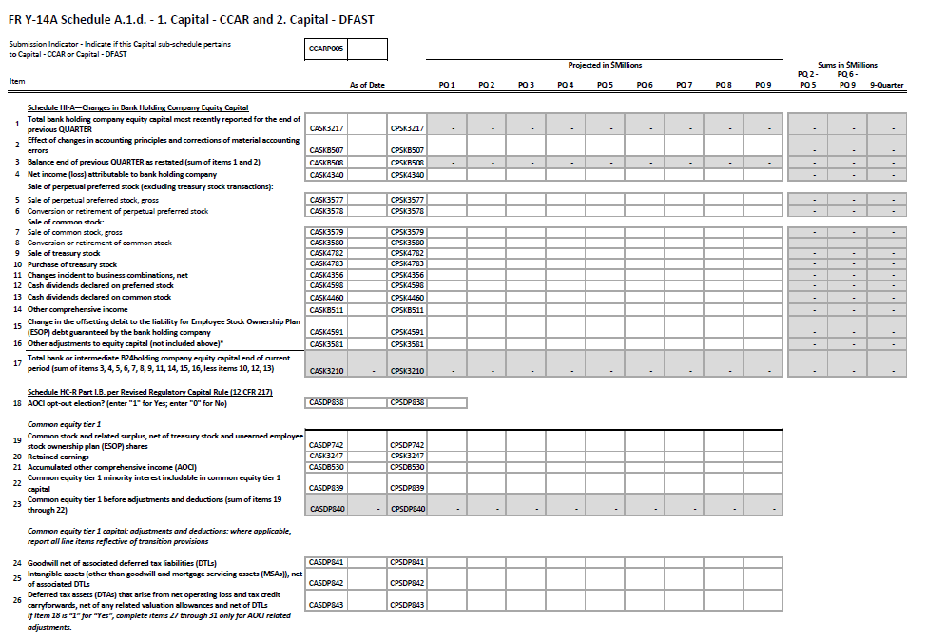
Form FR Y-14 A Snapshot

Slide 6
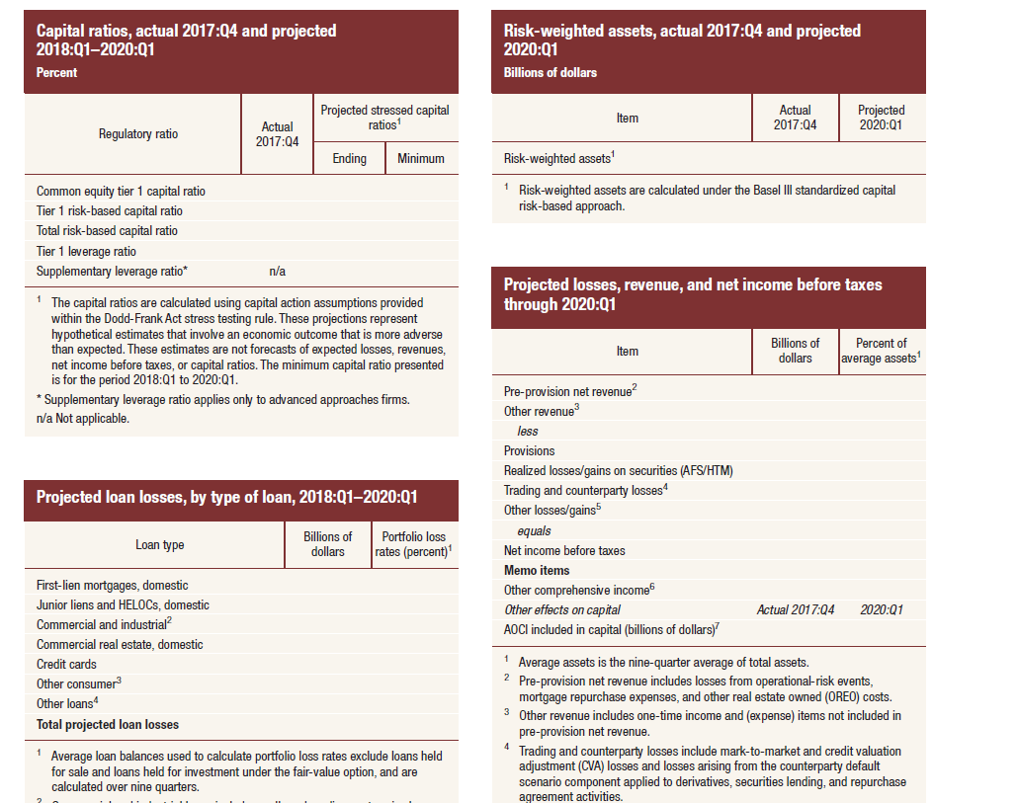
Form FR Y-14 A Snapshot

Slide 7
CCAR Process
Capital Plan rule includes:
1. Assessment of Expected use and sources of capital
2. Detailed description of the firm’s process for accessing capital adequacy
3. The Firm’s capital policy
4. A discussion of any expected changes to the firm’s business plan that are likely to have a material impact on the firm’s capital adequacy or liquidity.
Approval of Capital Plan by firm’s Board of Directors.
Submission of Capital Plan to the Federal Boards.
*For CCAR 2018, capital plans should have been submitted to the Federal Reserve no later than April 5, 2018.
Board Conducts Quantitative & Qualitative review of capital plan:
Board may decide to object or to not object on the plan and ask for more supporting docs if required.
*Board published results of assessment by June 30, 2018

Slide 8

Capital Plan Rule’s: Components
1. Assessment of the Expected Uses and Sources of Capital
Discussion of Stress Test Results Conducted by Firms:
Discussion of how the firm will maintain all minimum regulatory capital ratios:
Tier-1, Tier-2 Capital Ratios etc
Estimates of Projected Revenues, Losses, Reserves, and Pro Forma Capital Levels:
1. Global Shock
2. Counterparty default
3. Market Risk
4. Stress Tests
Supervisory baseline
Supervisory adverse
Supervisory severely adverse
BHC baseline
BHC stress
Description of all planned capital actions by the firm over the planning horizon:
Planned Capital Action
Alternative Action
3. DFAST Capital Action

Slide 9
Capital Plan Rule’s: Components
Description of Firm’s process for Accessing Capital Adequacy
-How you come about accessing if the capital adequacy assessments are adequate or not.
-Both in case of Base as well as Stress Scenarios
3. Expected Changes to Business Plans Affecting Capital Adequacy or Funding:
- What is the action plan in case of a big business change, for example: Merger, Consolidation, divestitures, Acquisitions

Slide 10
FRB’s Assessment: Qualitative
Applies to LISCC and Large & Complex firms only.
Fed ensures firm’s processes and policies are adequate.
Below are the aspects covered:
Assumptions and Analysis underlying the capital plan: Identification, Capture and Measurement of Risk. Model & Data Assumptions
Control & Governance over Capital Planning Process: Internal Controls and Audits, Controls around Data and Technology, Senior Management Oversight

Slide 11
FRB’s Assessment: Quantitative
Supervisory Post Stress Capital Assessment:
Checks for the Stress Test results
Majorly checks for data sufficiency or Missing Data
Post Stress Test adjustments to Planned Capital Actions

Slide 12
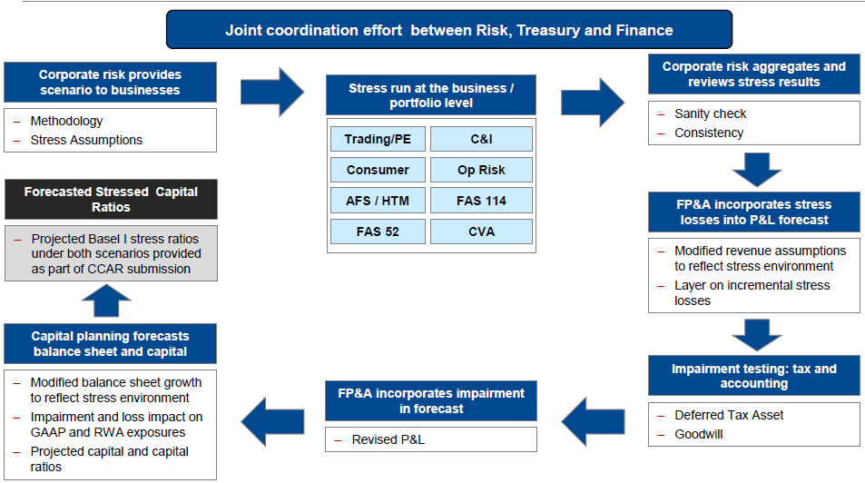
Stress Testing Workflow

Slide 13
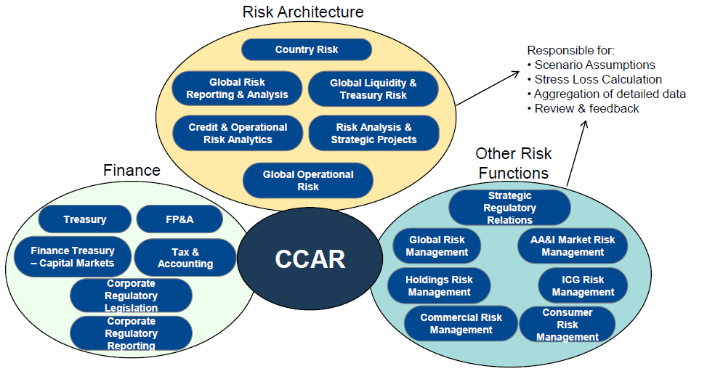
How is Risk Architecture involved?

Slide 14
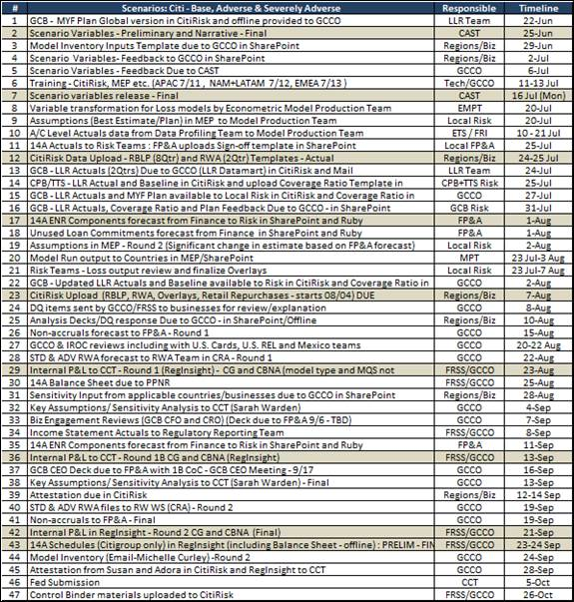
CCAR MCST Workflow

Slide 15
CCAR Production Process Inputs
New origination data is received from country
This file contains quarterly balances for the new accounts
This helps predict the new accounts losses
Macro-economic files are based on scenarios (Base, Adverse, Severe Adverse)
Files are received from econometric team
Quality checks are carried out for portfolio specific variables
Macroeconomic Data
New Origination
Loan Level Data
Cash Flow Engine
The loan level data on which the models are run to generate the loss forecasting results.
It is downloaded from MCP portal.

Slide 16
Production Functional Flow Diagram
CFE Inputs
CFE Logic
CFE Output
Production Inputs
Model Specification
Core Functions
Data Preprocessing
Pre-process CFE input data
New account originations
PD Engine
Unit and Balance flows
Amortization
CLTV
EAD calculations
LGD Engine
Haircut logic
Liquidation logic
GCL calculations
Recovery logic
NCL calculations
Reporting Engine
Account Level Output
Summarized Output
Macro Scenarios
Snapshot Data
CFE: System Configuration
Parameters
Model Parameters and Assumptions
History Data
New Origination Assumptions
Notes:
Linked with slide no 6 as Hyperlink.

Slide 17
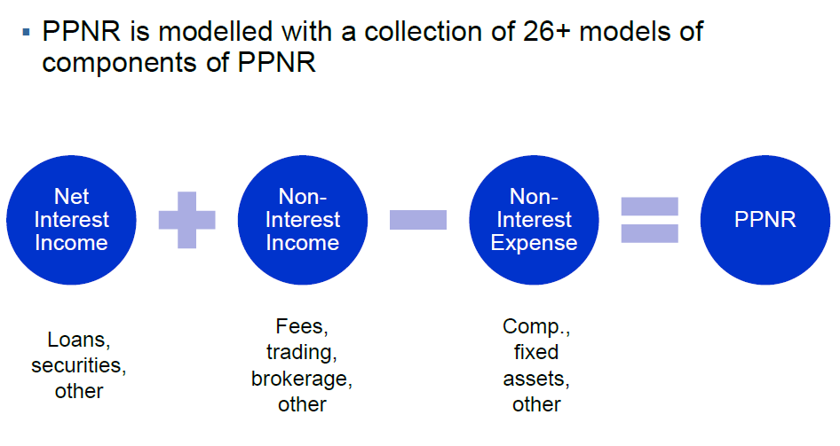
Pre Payments Net Revenue

Slide 18
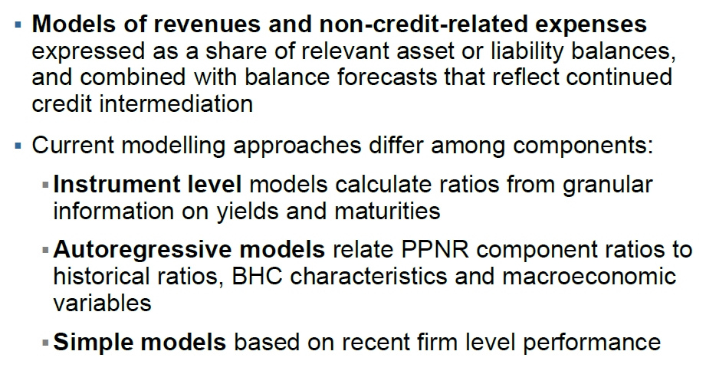
PPNR Models

Slide 19
Questions?

Slide 20
Mortgage Risk: CCAR Vs DFAST
CCAR Mortgage Risk is declining YoY, whereas there can be seen a upwards trend in DFAST Mortgage Risk.
DFAST Mortgage Activities boomed in 2013. there can be seen a declining trend in CCAR Mortgage activities.
DFAST impaired mortgage loans are experiencing a Rise compared to a consistent decrease in CCAR impaired mortgage loans.

Slide 21
Sneak Peak into Stress Testing
Balance-sheet assessments that analyze a bank’s solvency by placing it under hypothetical unfavorable economic circumstances.
Concentrating on liquidity, market and credit risks banks may face when their financial health is strained.
For example, an actual recent stress test scenario simultaneously factored in a 21% drop in housing prices, a 50% decline in equity prices, a 5% drop in gross domestic product, and an unemployment rate of 13%. The test looks at a bank’s Tier 1 common capital ratio, which is the common equity component of capital-to-risk-weighted assets.

Slide 22
CCAR Process & Instructions
The Federal Reserve releases annual CCAR scenarios in January, and BHCs are expected to submit their capital plans and stress tests based on these scenarios in April. 5–7 capital plans are required for each participating BHC, based on the three supplied scenarios and two scenarios that the BHC will create for itself.
The Federal Reserve will give each BHC feedback on adherence to CCAR requirements and release the results in June. This feedback is a critique of the BHC’s capital plans, stating where the plans are optimum and where they need work.
BHCs can go ahead as early as July 1 with public quarterly plans to deploy excess capital and move forward with share buybacks and dividend payments as stated in their capital action plans.
The BHC’s expenditure must meet the expectations outlined in its capital plans or it will have to request permission to proceed from the Federal Reserve.

Slide 23
CCAR Scenarios
The CCAR is made up of capital action plans from BHCs that are based on several hypothetical scenarios. It is like a fire drill: the government supplies the BHCs with example situations, and the BHCs prepare how they would handle these imaginary situations based on their capital and their management strategies.
The federal government supplies three CCAR scenarios that range from normal to extreme situations (details are based on year 2016 scenarios):
Baseline – is based on the average projections of economic forecasters
Adverse – is a hypothetical situation involving moderate recession or mild deflation that causes weakened economic activity
Severely Adverse – is a hypothetical situation involving a severe global recession with U.S. unemployment rates rising to 10 percent, a heightened period of corporate financial stress, and negative yields for short-term U.S. Treasury securities
All participating BHCs are expected to create two of their own scenarios and supply actions plans. One must be based on baseline expectations, and one must be based on a stress scenario, meaning that each BHC is required to submit action plans for 5 total scenarios.

